Slide 1
Governor's 100 Day Challenge Launch Workshop
Lake County training cohort
Sponsored by: Re!nstitute

Slide 2
Introductions
Name
Agency or Organization
Role within the Community
Ice Breaker – If you were a Breakfast cereal what would you be?
Popcorn – Tag to a friend

Slide 3
Sponsored by: Partnered With:

Slide 4
Launch Workshop Agenda:
Day 1
Day 2
Welcome and Introductions
100 Day Challenge Overview
Setting the Context and Clarifying the Challenge
Analysis of Our Current System
Overview of the Re!nstitute Approach
Setting Goals
Preparing for Action
Wrap Up
Welcome Back
Review Objective
Where are we on Data
Work Planning Part 1: Idea Generation
Work Plan Part 2: Workstreams and Milestones
Work Plan Part 3: Building Detailed Action Plans and Aligning the Work Plan
Next Steps

Slide 5
Overview
Objectives
Challenge Timeline
Roles

Slide 6
Objectives
Establish a shared understanding of the key challenges framed by local System Leaders
Define and commit to an ambitious and exciting100-Day Goal
Generate innovative ideas to achieve the goal and develop detailed action plans
Share the goal and the plan with System Leaders and make asks

Slide 7
Fill in with Timeline
Week of Aug 29
Week of Oct. 24
Week of Nov. 14
June 9
Today
July 6
Aug. 25
Oct. 14

Slide 8
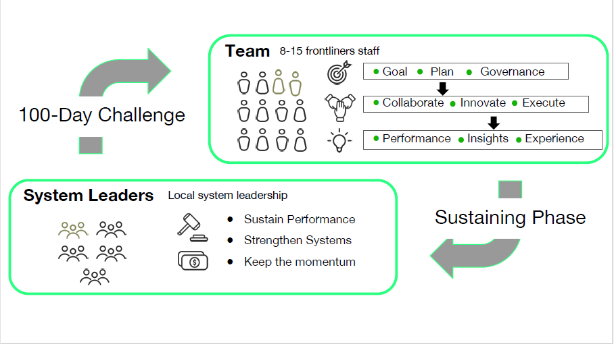
Roles

Slide 9
Video

Slide 10
Focus Areas
System Leaders Picks Youth up to the age of 24 with an emphasis on:
~ McKinney Vento ~ System Involved ~ Tribal ~
McKinney Vento’s Definition of Homelessness including families, couch surfing, and doubled up.
System Involved will include youth and families in the systems of care including the justice system, behavioral health system, and foster care system.
Tribal will include enrolled Tribal members, disenrolled tribal members, and Natives who can’t enroll

Slide 11
Data Compiled From:
~ 3/1/22-5/31/22 HMIS ~ 2022 PIT ~ 2021-2022 LCOE ~ 2022 LCBHS ~
Ages up to 17 – 32% (LCOE)
Families – 34% (HMIS & PIT)
Tribal – 33% (HMIS & PIT)
Mental Health – 30% (HMIS & PIT)
TAY 18 thru 24 – 8% (HMIS & PIT)
Incarcerations – 13 Total (LCBHS)
Psych Emergencies – 7 Total (LCBHS)

Slide 12
Unsheltered Pit Breakdown for Youth Total of 23 Unaccompanied Youth
Race/Ethnicity
Hispanic/LatinX - 2
Non-Hispanic/Non-Latinx – 21
Native/Indigenous - 16
Asian - 0
Black - 0
Pacific Islander - 0
White - 7
Multiple - 0
Gender
Female - 10
Male - 13
Gender not singularly ‘Female or Male’ - 0
Questioning - 0
Transgender - 0
Unaccompanied Youth
Under 18 ~5
18 thru 24 ~18

Slide 13
Break

Slide 14
System Analysis
When thinking of our system AS IT IS today:
What is the beginning?
What is the end?
What does the process look like for a client?
100 Day Challenge - Google Jamboard

Slide 15
Overview Of re!nstute methodology
Unreasonable but believable goals
Experience and expertise of frontline staff
Centering lived experience
Creating a sense of urgency
Creating a culture of experimentation
Using data as a compass
Harnessing the power of peers
Leading with confident humility

Slide 16
Focus Areas
System Leaders Picks Youth up to the age of 24 with an emphasis on:
~ McKinney Vento ~ System Involved ~ Tribal ~
McKinney Vento’s Definition of Homelessness including families, couch surfing, and doubled up.
System Involved will include youth and families in the systems of care including the justice system, behavioral health system, and foster care system.
Tribal will include enrolled Tribal members, disenrolled tribal members, and Natives who can’t enroll

Slide 17
Data Compiled From:
~ 3/1/22-5/31/22 HMIS ~ 2022 PIT ~ 2021-2022 LCOE ~ 2022 LCBHS ~
Ages up to 17 – 32% (LCOE)
Families – 34% (HMIS & PIT)
Tribal – 33% (HMIS & PIT)
Mental Health – 30% (HMIS & PIT)
TAY 18 thru 24 – 8% (HMIS & PIT)
Incarcerations – 13 Total (LCBHS)
Psych Emergencies – 7 Total (LCBHS)

Slide 18
Unsheltered Pit Breakdown for Youth Total of 23 Unaccompanied Youth
Race/Ethnicity – Total 23
Hispanic/LatinX - 2
Non-Hispanic/Non-Latinx – 21
Native/Indigenous - 16
Asian - 0
Black - 0
Pacific Islander - 0
White - 7
Multiple - 0
Gender – Total 23
Female - 10
Male - 13
Gender not singularly ‘Female or Male’ - 0
Questioning - 0
Transgender - 0
Unaccompanied Youth – Total 23
Under 18 ~5
18 thru 24 ~18

Slide 19
90 Days in HMIS we housed 28, 4 were Doubled Up, 8 individuals were families with youth, and 0 were Tribal.
~ Setting the Goals ~
Who are we targeting?
What are we focusing on?
By how much?
100 Day Challenge - Google Jamboard

Slide 20
Break

Slide 21
Team Leads
Facilitate Weekly Meeting
Work Directly with the Sponsors and Ambassadors
Reps to the SL Team
Make sure the team is on track

Slide 22
What’s Next
Welcome Back
Review Objective
Where are we on Data
Work Planning Part 1: Idea Generation
Work Plan Part 2: Workstreams and Milestones
Work Plan Part 3: Building Detailed Action Plans and Aligning the Work Plan
Next Steps

Slide 23
Q & A

Slide 24
Governor's 100 Day Challenge Launch Workshop Day 2
Lake County training cohort
Sponsored by: Re!nstitute

Slide 25
Introductions
Name
Agency or Organization
Role within the Community
Ice Breaker – If you could be a superhero who would you be and why?
Popcorn – Tag to a friend

Slide 26
Objectives
GOAL –
In 100 Days Lake County will House 60 individuals, with 70% being Households with at least 1 youth OR Tribal affiliation, 10% being LGBTQ+ or System Involved, 20% being unaccompanied.
Establish a shared understanding of the key challenges framed by local System Leaders
Define and commit to an ambitious and exciting100-Day Goal
Generate innovative ideas to achieve the goal and develop detailed action plans
Share the goal and the plan with System Leaders and make asks

Slide 27
Launch Workshop Agenda:
Day 2
Welcome Back
Review Objective
Where are we on Data
Work Planning Part 1: Idea Generation
Work Plan Part 2: Workstreams and Milestones
Work Plan Part 3: Building Detailed Action Plans and Aligning the Work Plan
Next Steps

Slide 28
Where are we on Data
How can we track our OVERALL progress?
Where are all the places we need to start collecting data from?
Who will capture it and where will it be stored?
What are the gaps in data collecting and indicators that we hope to strengthen over the next 100 days?

Slide 29
Overview of work planning
Visioning
Idea Generation
Identifying Work Streams

Slide 30
Vision Board
Close your eyes!
Envision it being a year from the end of the Challenge- we have far exceeded our goal and sustained our progress and are generally rocking it!
What’s different about YOUR work in particular? What has the SYSTEM accomplished/how is it different?

Slide 31
Work Planning 1 Idea Generation
Review Goal ~ In 100 Days Lake County will House 60 individuals, with 70% being Households with at least 1 youth OR Tribal affiliation, 10% being LGBTQ+ or System Involved, 20% being unaccompanied.
Review Day 1 System Map
What actions need to occur to reach our goal
100 Day Challenge - Google Jamboard

Slide 32
Break

Slide 33
Work Planning 2 - Workstreams and Milestones
Identify Workstreams
Create Milestones

Slide 34
Identifying Workstreams
Begin to Cluster Ideas into Themes
These Clusters will become Workstreams
Are we using the Right Workstreams to Accomplish our Goal?

Slide 35
Milestones

Slide 36
Reality check
If we establish all these milestones, is that enough to achieve our overall 100-day goal?

Slide 37
Break

Slide 38
WORK PLANNING PART 3:
Detailed Action Plans
Aligning the Work Plan

Slide 39
What’s next
Team Leads will meet with Sponsors and Ambassadors.
Weekly Team Meeting day and time will be established, and invites set out to team.

Slide 40
Q & A

Slide 41
Thank You

